Slide 1
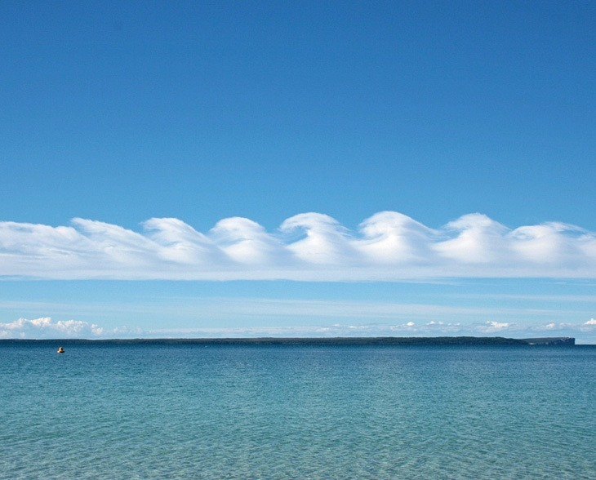

ATSOA - 2024
Numerical Simulations with PLUTO code
Presented by:
Ankita Thapa
University Of Science And Technology Meghalaya
Sonal Singh
DDUGU, Gorakhpur
Dasarathi E G
University of Madras
Devendra Bhusakhare
PTRSU, Raipur
Under the guidance of
Priyesh Kumar Tripathi

Slide 2
CONTENTS
INTRODUCTION
INSTABILITY
KELVIN-HELMHOLTZ INSTABILITY
RAYLEIGH-TAYLOR INSTABILITY
RESULT
CONCLUSION

Slide 3
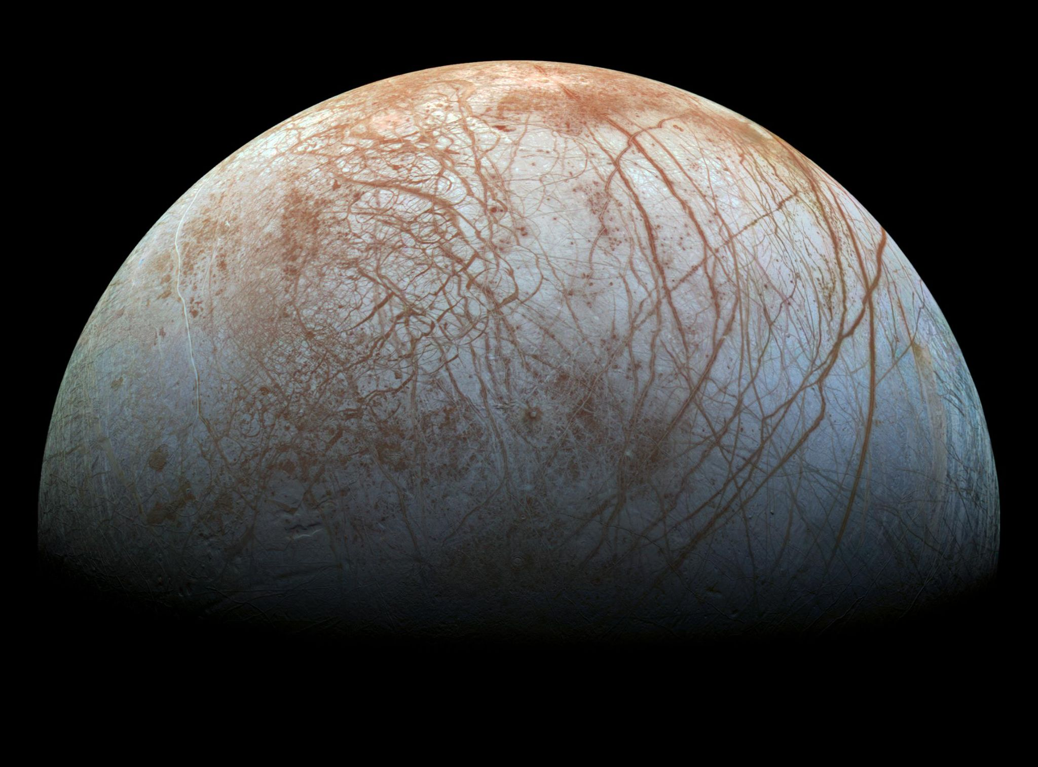
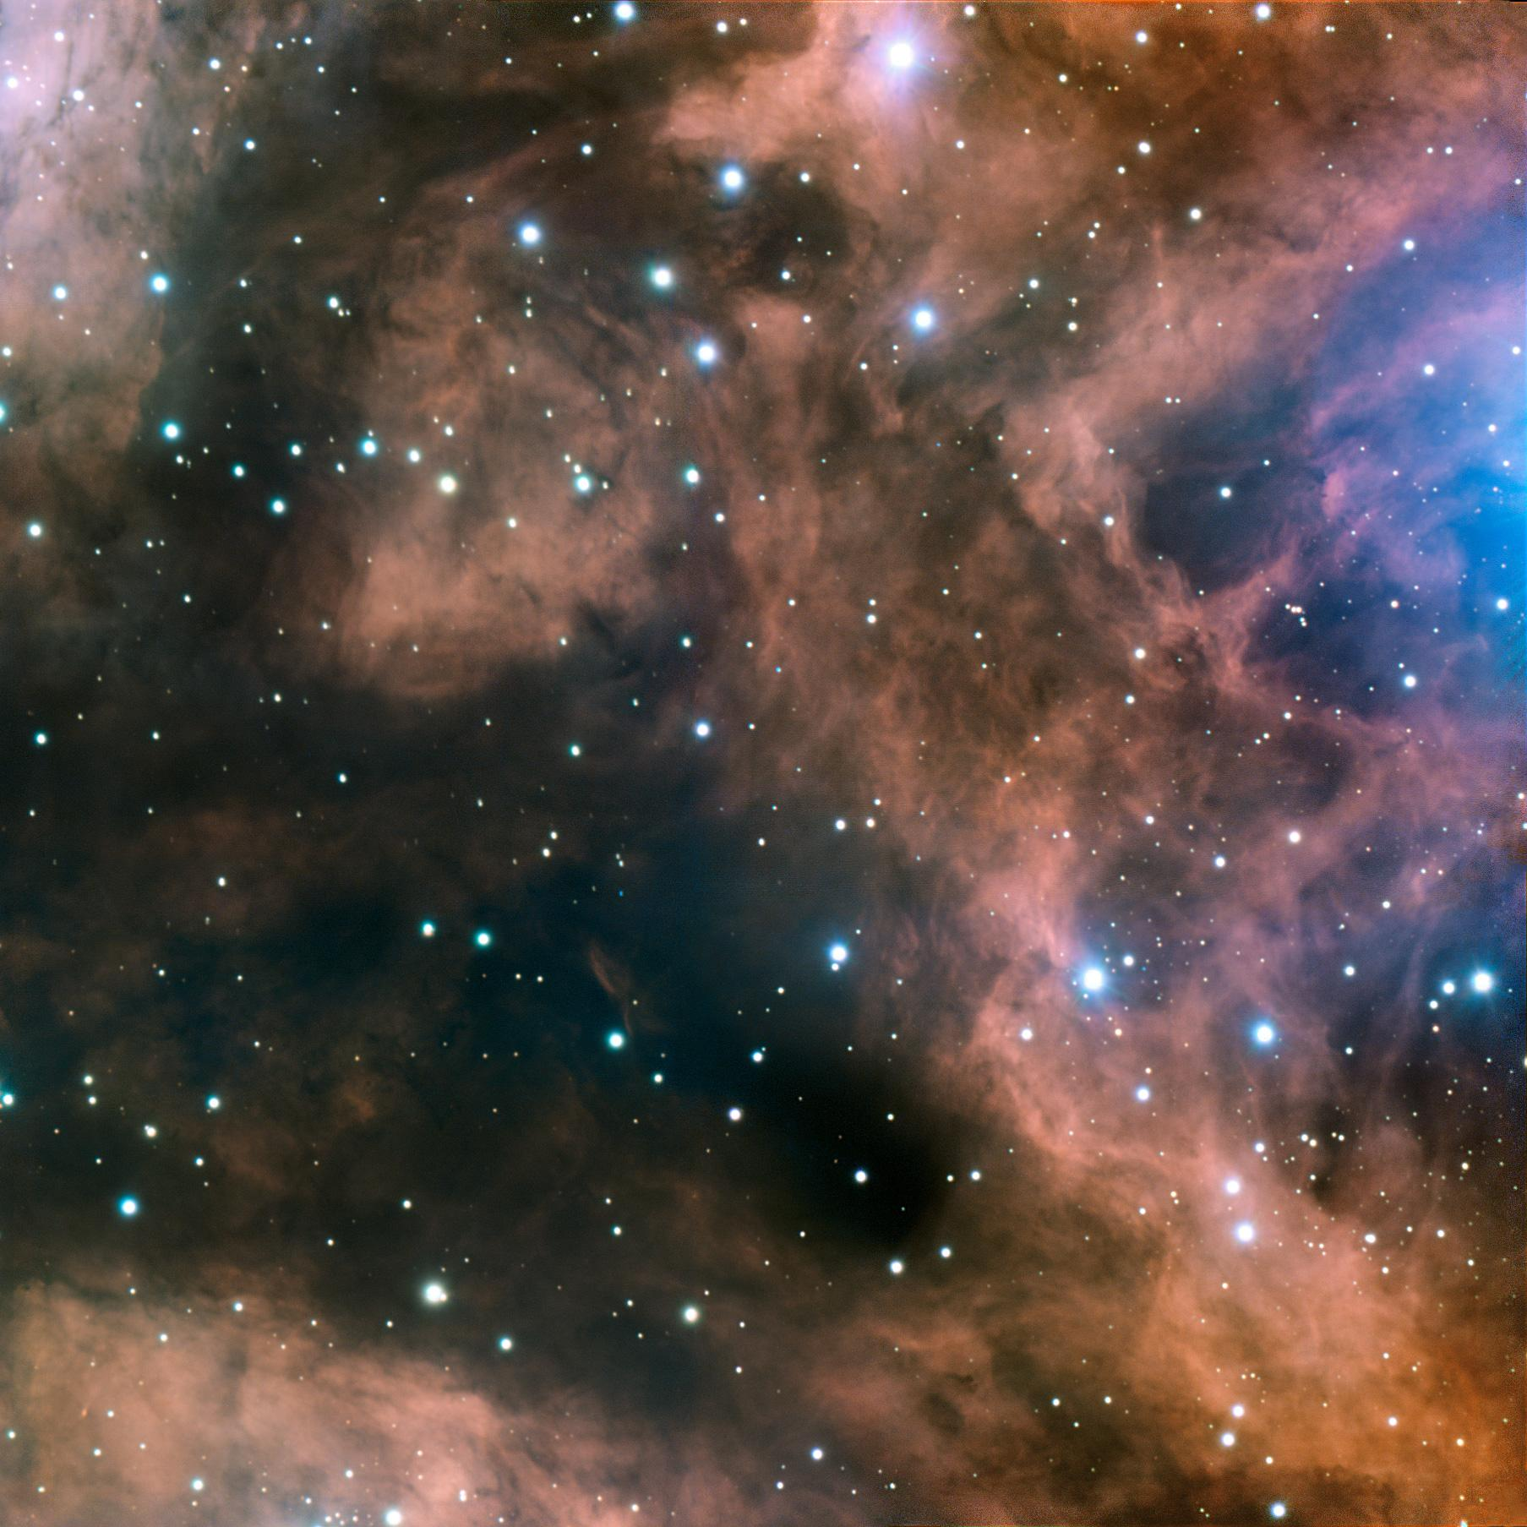
INTRODUCTION
Astrophysical Fluids
Most of the matter in our Universe can be treated as fluid.
A continuous medium with well defined macroscopic quantities (density, pressure etc.) can be considered as Fluid.
They can be gaseous (Interstellar clouds) or liquids (water in moon of Jupiter) form.
NASA/JPL Caltech/SETI institute
Fluid Dynamics
Behaviour of fluids can be described using fluid dynamics and can be understood via fluid equations which are based on conservation of mass, momentum, energy.
These equations form the basis for modeling and analyzing fluid flows like that in astrophysical simulations.
ESO

Slide 4
Numerical Simulations
PLUTO Code
They are computational models used to study physical systems and phenomena by solving mathematical equations representing the behaviour of the system.
There are several codes and software packages available for simulating astrophysical fluid dynamics, each with its own strengths, features, and areas of application.
Examples: PLUTO, FLASH, Athena, AMRVAC
Pluto is a computational astrophysics code, developed by Andrea Mignone. It basically solves a system of partial differential equations (conservation laws)
It is designed for performing simulations of astrophysical fluid dynamics, e.g. accretion disk, jets and other phenomenon.
Written in C, C++ & Fortran
Open-source software (allows users to modify and extend the code to suit their specific research needs).

Slide 5
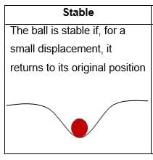
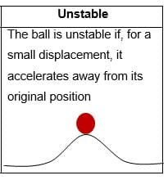
INSTABILITY
Small perturbation in any system.
If perturbation decays with time or oscillates
Stable
If perturbation grows in time
Unstable

Slide 6
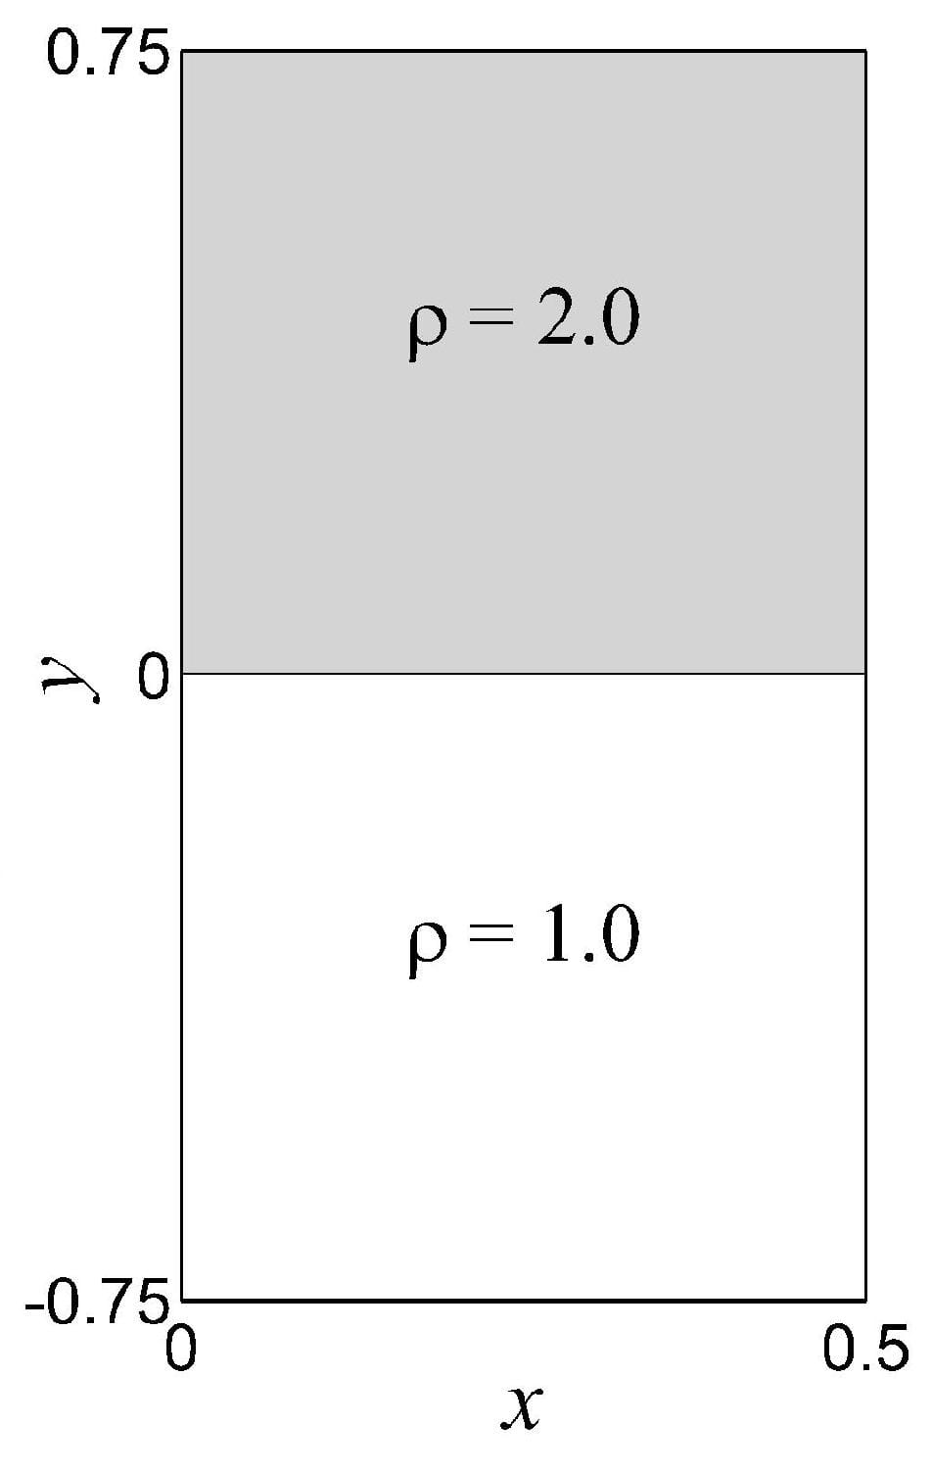
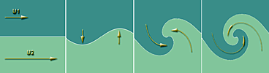
KELVIN-HELMHOLTZ INSTABILITY
RAYLEIGH-TAYLOR INSTABILITY
KH Instability occurs when there is velocity shear in a single continuous fluid or a velocity difference across the interface between two fluids.
Ex. KH clouds, Red spot on Jupiter.
The RT instability is an instability of an interface between two fluids of different densities which occurs when a denser fluid is placed over a lighter fluid under the gravity.
Ex. RT fingers in supernova explosions.
g

Slide 7

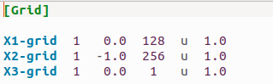
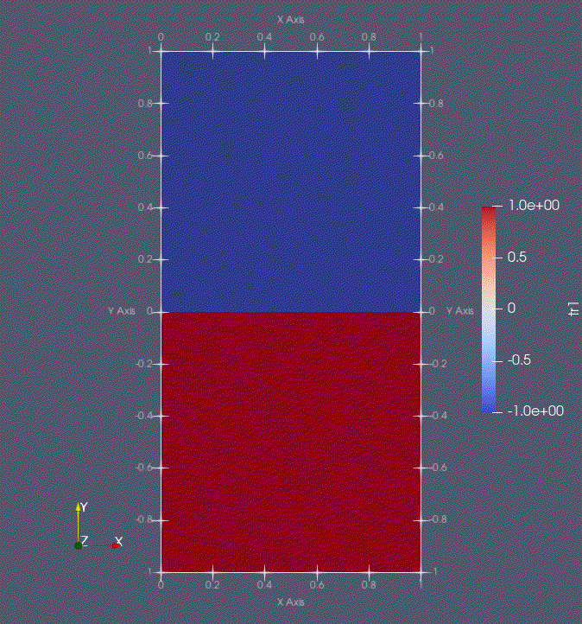
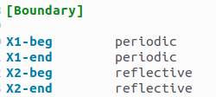
KH Instability Simulation
kval= 1
ρ = 1.0 (density)
Vx = 0.5*tanh(y/a)
Vy = 1.e-2 * sin(kval*2*π*x)*exp(-y*y)
P = 1/gamma
Initially the density of the fluid is same in the computational domain.
Different layers of the fluid are flowing with different velocity i.e a velocity shear is present there
The fluid is perturbed by giving a very small velocity in the y direction (Vy).
“Kval” renders the number of vortices.

Slide 8
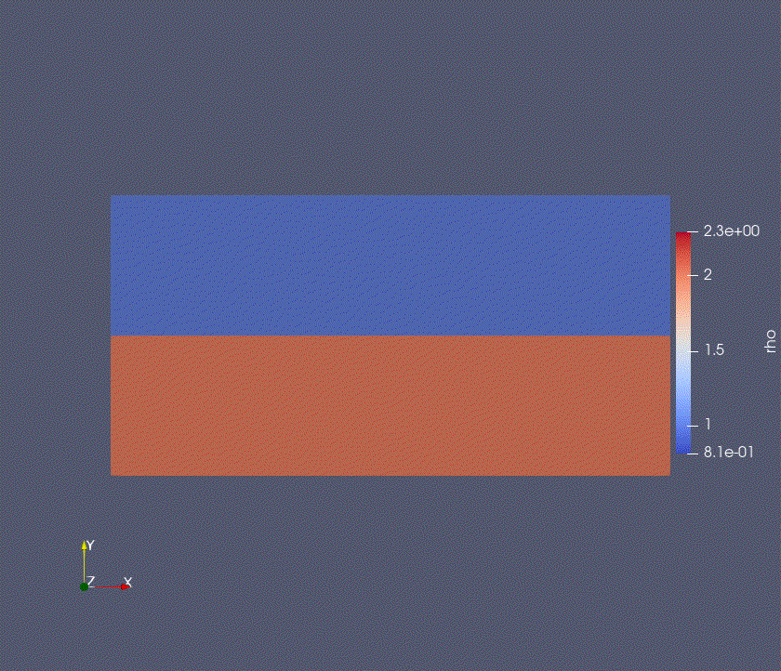
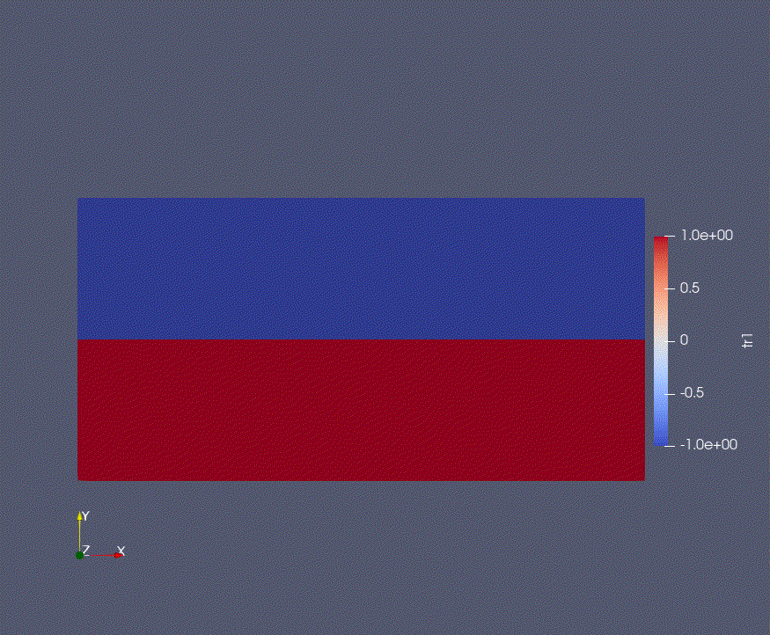
KH Instability: Continuous media and two fluid interface
kval= 3
The upper simulation shows the two different fluid layers separated by an interface with velocity shear between different layers.
The lower simulation shows the single continuous fluid with velocity shear between different layers.
This simulation shows that, If velocity shear is present then KH Instability can be observed.

Slide 9
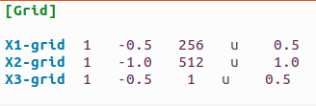
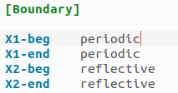
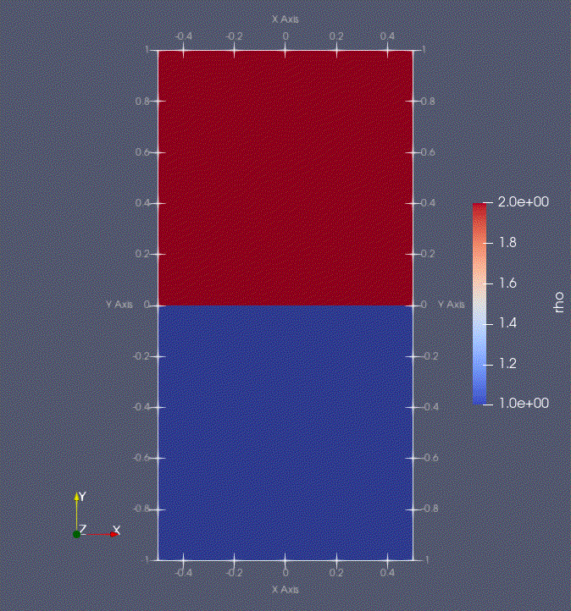
Rayleigh-Taylor Instability Simulations
Initially the higher density of the fluid is at top and lower density fluid is at bottom.
A small perturbation is given in the interface of the media.
Due to gravity higher density fluid comes down.
And due to the velocity shear, we can notice KH instability.

Slide 10
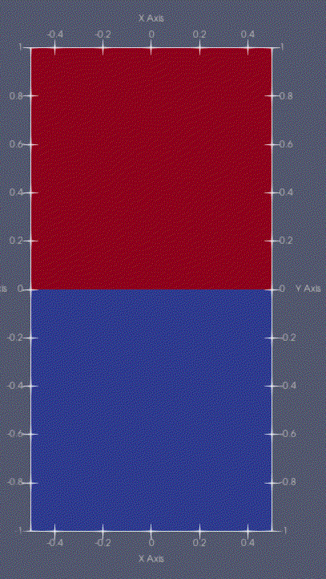
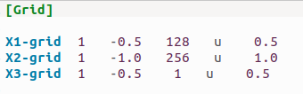
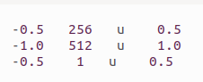
RT Instability: Effect of Resolution
Left simulation is with lower resolution [128 x 256] and the right simulation is with higher resolution [256 x 512]
We can see that in the higher resolution the number of KH vortices are prominent than the number of KH vortices in the lower one and
The vortices in the higher resolution are well resolved than the lower one.

Slide 11
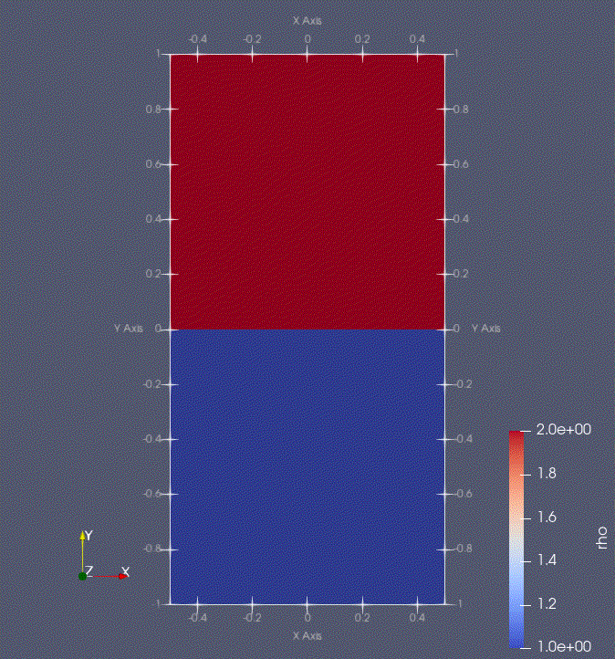
RT Instability: Effect of Magnetic Field
Magnetic field is initially in x-direction. (chi: a measure of magnetic field strength)
We can see that the instability are suppressed by the magnetic field.
chi= 0
chi= 0.2
chi= 0.4

Slide 12
CONCLUSION
In this project, we learnt about basics of simulations using PLUTO code.
We conducted simulations of the Kelvin-Helmholtz Instability in both continuous media and in two fluids with differing densities.
We also simulated the Rayleigh-Taylor Instability and examined how resolution and magnetic fields affect the RT instability.

Slide 13
THANK YOU

